Slide 1
VR251 Art Showcase Presentation Wool Felt DIY Chongdan Pan Group 3
Notes:
Hello, everyone, welcome to my VR251 Art Docent Presentation, my topic is Wool Felt DIY.

Slide 2
Wool Felt DIY Introduction
What？
Make a small doll through wool felt
How?
Using needle to shape the wool felt by poking
Notes:
So what is Wool Felt DIY? It’s quite simple. It’s about making a doll by poking wool felt through needle.

Slide 3
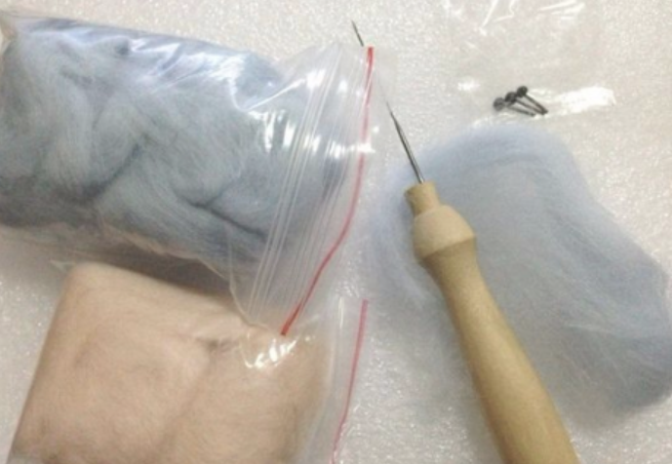
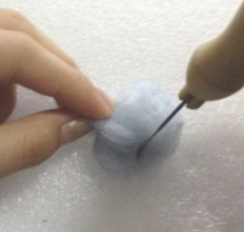
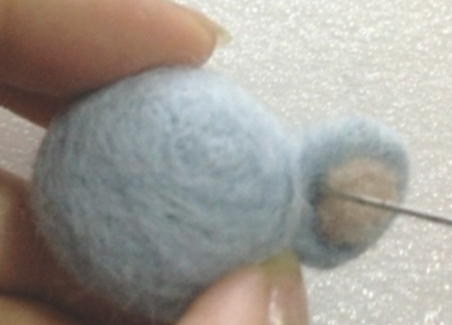

Wool Felt DIY Procedure
Preparation
Needle
Wool Felt
Shaping
Poke the wool felt
Direction is the key
Attaching
Poke to attach different parts
Notes:
The procedure is quite simple. First, you need do prepare raw materials and tools, which is needle and a lump of wool felt. Then you can shape the wool felt by using the needle to poke it. The direction is important, because the part where your poke will pinch in the direction. If you keep rotating your wool felt when poking, it will becomes a ball. You can also combine wool felt of different color to make a colorful one. When you complete making some small shape, you can attach them together by poking.

Slide 4
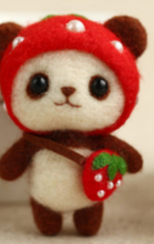
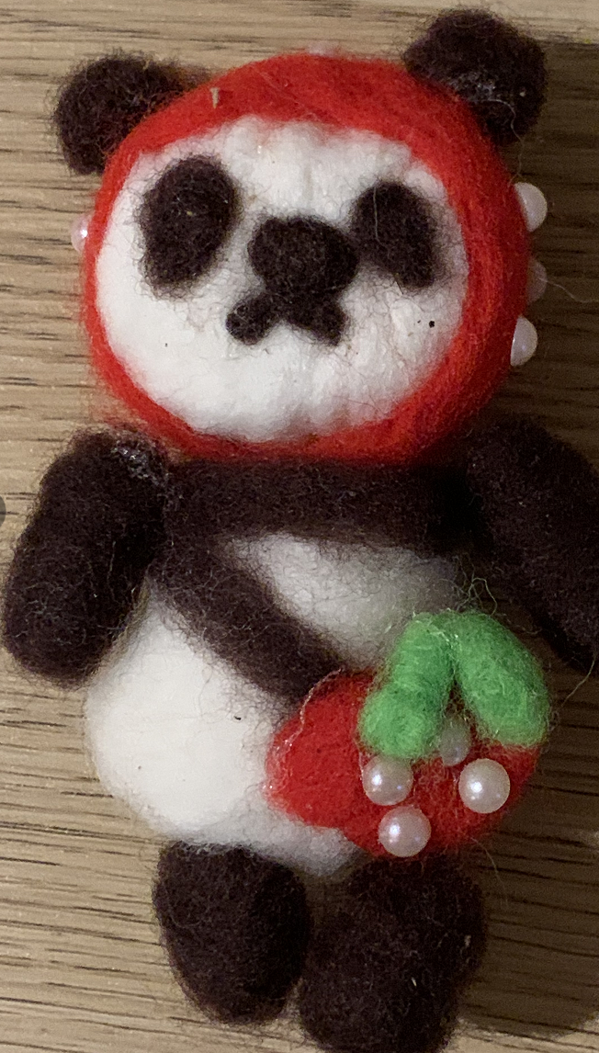
My Wool Felt DIY Artwork
It should be
and mine actually is
Notes:
I’ve tried to make a Wool Felt PANDA. However, this is it ideal form, and mine actually is a bit rough. Actually, it requires patience and skills, and it’s very hard to make one like the first panda.

Slide 5
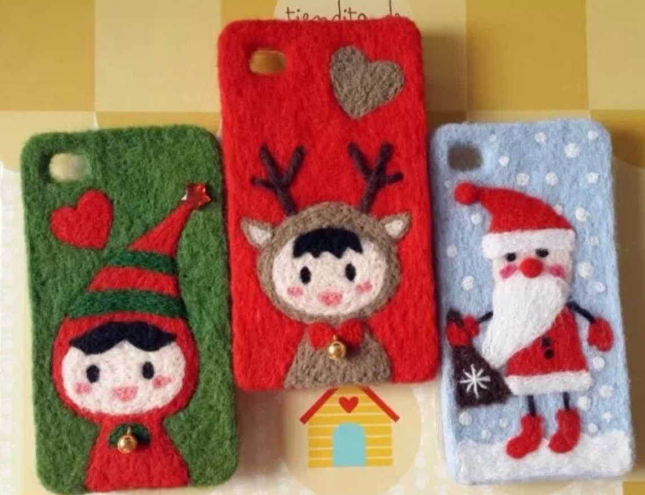
Aesthetic Analysis
As an artwork
Imitative, representative
As a technique
Formalistic
Notes:
Is wool felt DIY an art? I would definitely say is. As an artwork, artist can use it to make imitation or represent what he want to express. So it conforms the three art theories. As a technique, the skill is a typical form to make artwork, so it’s also conforms the formalism. More important, through the procedure, we can get the experience that all other art has.

Slide 6
Thank you
Notes:
That’s all, thank you for listening my presentation

